Slide 1
Chapter 21
Electric Potential
1. Circulation Theorem and Electric Potential
2.Relation Between Electric Potential and Electric Field
3.The Calculation of Electric Potential
4.Equipotential Surfaces
5.Electrostatic Potential Energy

Slide 2
New words and Expressions
electric potential 电势
potential difference 电势差,电压
circulation theorem 环路定理
electric potential energy 电势能
equipotential surfaces 等势面
electric potential gradient 电势梯度

Slide 3
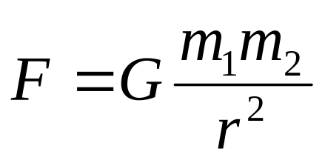
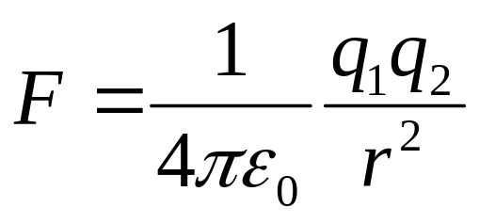
21-1&21-8 Circulation theorem of Potential,
Electric Potential and Electric Potential Energy (p503-505, p515)，
1. Features of Electrostatic Force
Newton’s Law for gravitational force:
Coulomb’s Law for electrostatic force:
Many properties for the gravitational may also be true for electrostatic forces.

Slide 4

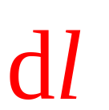
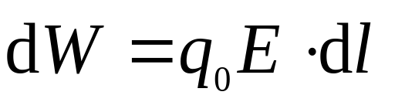
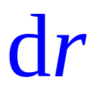


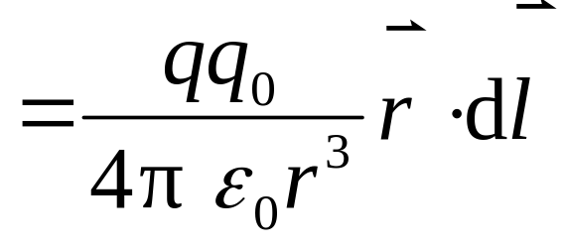
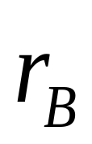

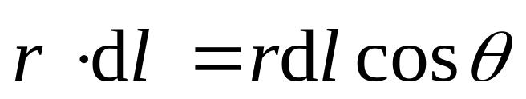

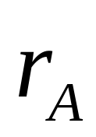

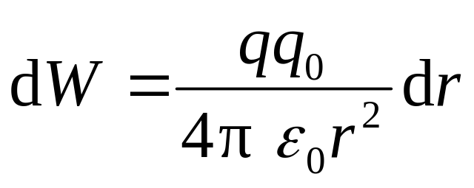
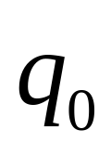
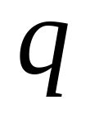

1) Work done by Electrostatic Force
点电荷的电场
Electric field of a point charge

Slide 5
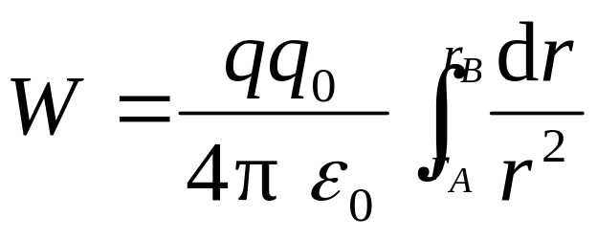
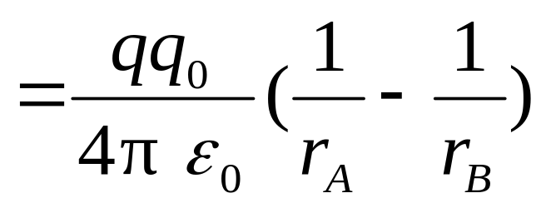
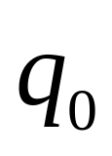

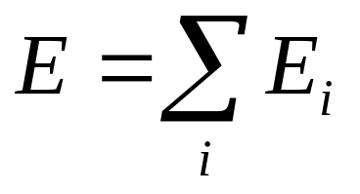
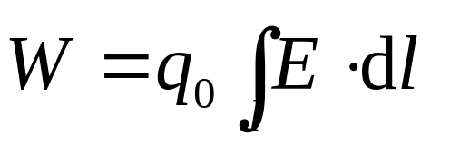
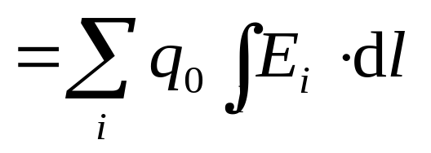
结果: 仅与 的始末位置有关，与路径无关.
任意电荷的电场（视为点电荷的组合）

Slide 6
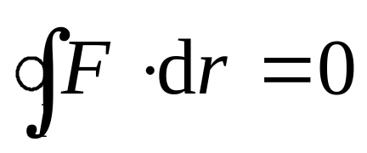
结论：静电场力做功与路径无关.
The work done by electrostatic force is path independent.
静电场是保守场，静电力是保守力。
The electrostatic force is a conservative force.

Slide 7
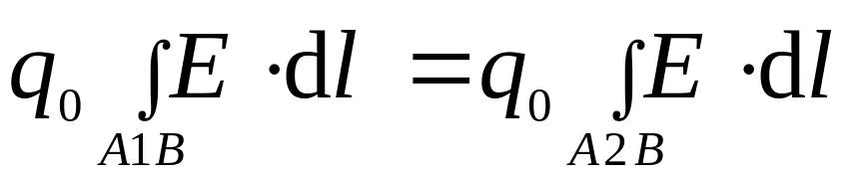
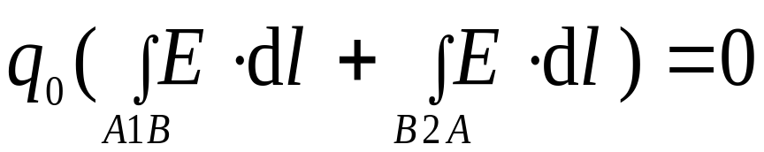


2) Circulation theorem: 静电场的环路定理
在静电场中，电场强度沿闭合路径的线积分等于零。或电场力移动单位电荷沿闭合路径一周所做的功为 0。
The line integral of the electrostatic field around a closed loop is zero.
1
2

Slide 8
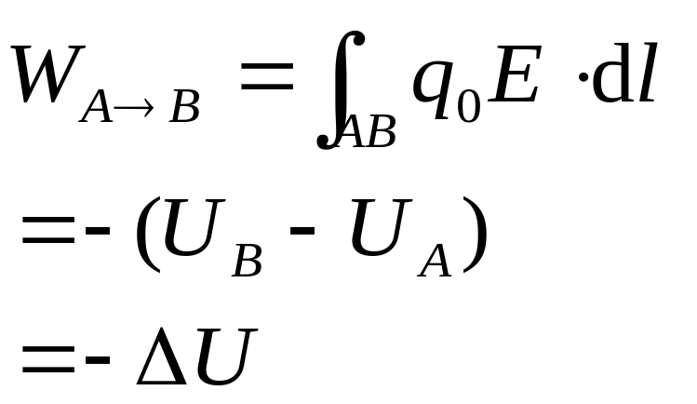


2. Electric Potential Energy 电势能(P515):
Because electrostatic force is a conservative force, an electric potential energy U can be introduced:
静电场是保守场，静电场力是保守力.静电场力所做的功就等于电荷电势能增量的负值.

Slide 9
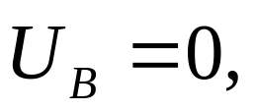
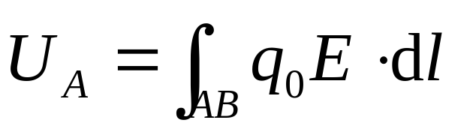

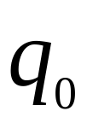
To ensure U at a point, a reference potential energy should be chosen:
The U of charge q at arbitrary point a = the work done by the during the move of charge q from a to infinity.
试验电荷 在电场中某点的电势能，在数值上就等于把它从该点移到零势能处静电场力所作的功.

Slide 10
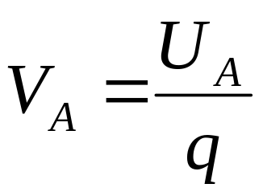
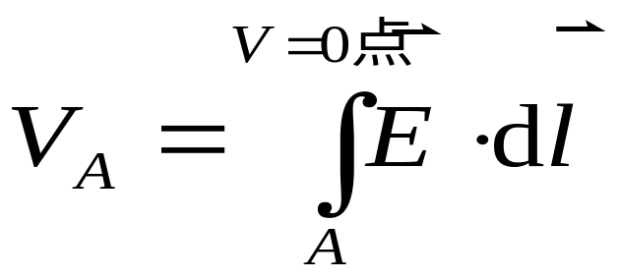
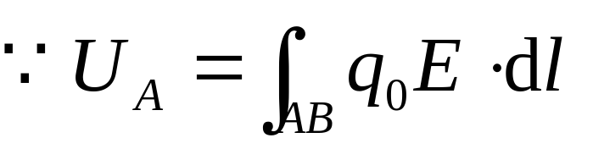

3. Electric Potential (P503):
Electric potential at point a is the potential energy per unit charge.
物理意义 把单位正试验电荷从点 移到电势零点时，静电场力所作的功.
The V in magnitude at point A equals to work done by the on unit positive charge during the move from A to zero point.

Slide 11
Descriptions:
1.V is a property of an electric field, regardless of whether a charged object has been placed in that field.
2. The unit in SI is volt. 1V=1J/C.
3.电势零点选择方法：
有限带电体以无穷远为电势零点，实际问题中常选择地球电势为零.
Choose the potential to be zero at an infinite distance or the ground.

Slide 12
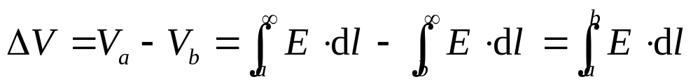
4 Electric Potential Difference (p503电势差,电压):
The ΔV between any two points a and b equals to in magnitude work done by the on unit positive charge during the move from a to b.
ΔV is independent on the choice of reference potential (电势的零点无论选在何处电势差不受影响).
The value of electric potential is relative, but the one of electric potential difference is absolute. (电势的大小是相对的,电势差是绝对的)

Slide 13
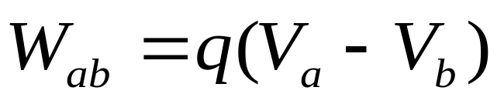
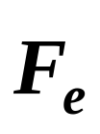
A convenient way of calculating work done to move a charged particle q through a potential difference ΔV from a to b (电场力所做功的计算方法):
In any situation, charged particle moves under , its potential energy U always tends to decreasing.
Thus a positively charged object moves naturally from a high potential to a low potential. A negative charge does the reverse.

Slide 14

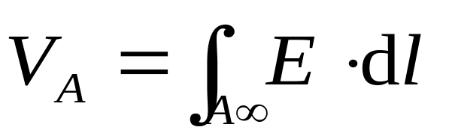
21-2 Relation Between Electric Potential and Electric Field (P505-507)

Slide 15




Example: Charged conducting sphere. Determine the potential at a distance r from the center of a uniformly charged conducting sphere of radius R for (a) r>R, (b) r=R, (c) r<R. The total charge on the sphere is Q. (p506)
真空中，有一带电为 ，半径为 的带电球壳.
试求（1）球壳外任意点的电势； （2）球壳上点的电势； （3）球壳内任意点的电势.
+
+
+
+
+
+
+
+
+
+
+

Slide 16
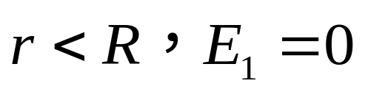
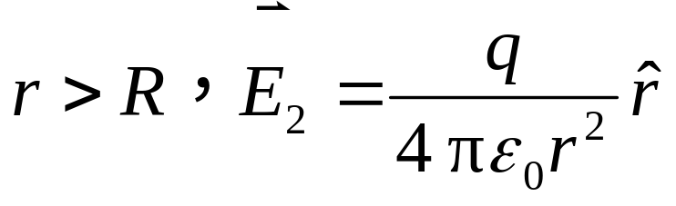


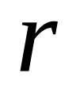

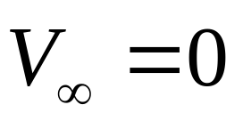

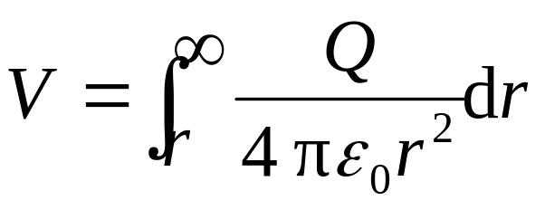
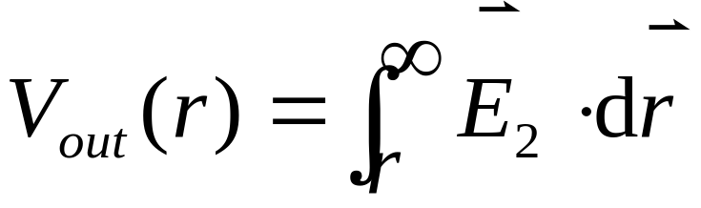
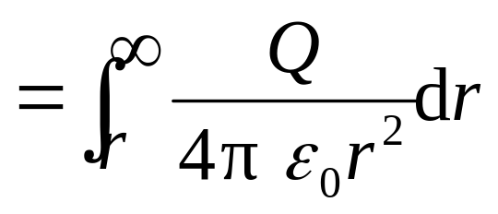
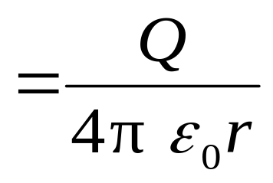
SOLUTION
+
+
+
+
+
+
+
+
+
+
+
Let V=0 for
（a）

Slide 17
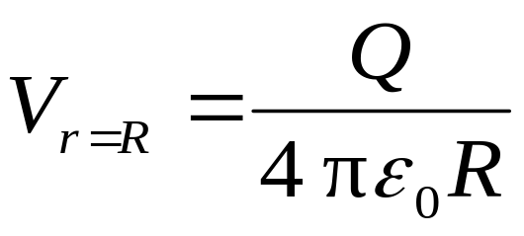

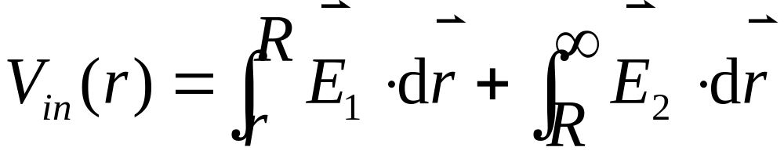
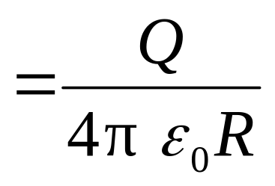
（b）
As r approaches R, we see that
at the surface of the conductor.
（c）
The whole conductor, not just its surface, is at the same potential.

Slide 18
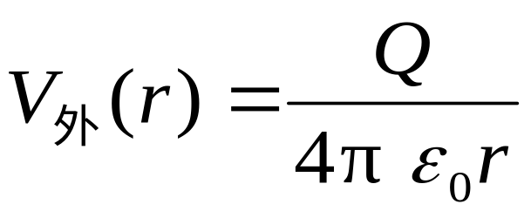

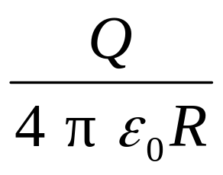
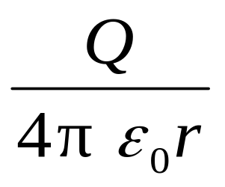
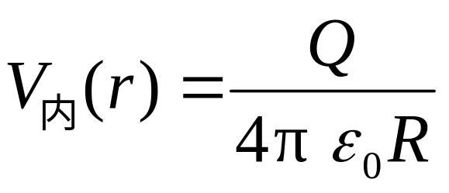


Plots of both E and V as a function of r are shown on next slide.

Slide 19





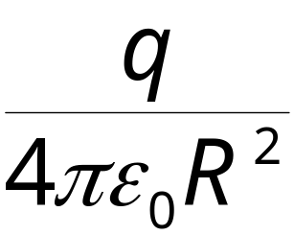
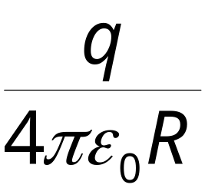

II
II
I
I

Slide 20

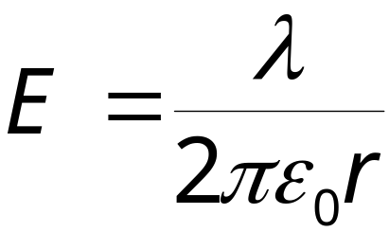

Example: Calculate potential distribution for infinitely long rod with charges λ.电直线线电荷密度为 λ ，求电势分布。
Solution:
The electric field of rod is
Let V=0 for

Slide 21




无意义
对无限带电体电势 0点不宜选无穷远点，也不选在导体上。

Slide 22









we assume B as the reference point,
P点在B点左侧.
P点在B点右侧.
电势零点位置不同，V_{p} 也不同，反映了电势的相对性。

Slide 23

Review
1 Work done by Electrostatic Force
静电场力做功与路径无关.
The work done by electrostatic force is path independent.
静电场是保守场，静电力是保守力。
The electrostatic force is a conservative force.

Slide 24
2 Circulation theorem: 静电场的环路定理
在静电场中，电场强度沿闭合路径的线积分等于零。或电场力移动单位电荷沿闭合路径一周所做的功为 0。
The line integral of the electrostatic field around a closed loop is zero.
3. Electric Potential Energy 电势能
试验电荷 在电场中某点的电势能，在数值上就等于把它从该点移到零势能处静电场力所作的功.

Slide 25

4. Electric Potential and Electric Potential Difference
物理意义 把单位正试验电荷从点 移到电势零点时，静电场力所作的功.
Relation Between Electric Potential and Electric Field

Slide 26




Example: A conducting sphere, of radius R and charge +q, is concentric with a spherical conducting shell of inner radius R₁ and outer radius R₂. This shell has a net charge of Q. (a) What are the charges on the inner and outer surfaces of the shell? (b) The potential of the sphere and the shell?
Solution:
B
Spherical symmetry, q uniformly distributed at inner surfaces
A
(a) Q_{in} = -q, (by using G.L)

Slide 27


(b) Potential of the shell B:
B
A
Potential of the sphere A:
How to get these conclusion using the definition of electric potential?
Question

Slide 28





21-3 Electric Potential Due to Point Charges (P507-511)
1. Potential Due to a Point Charge (P507-508)
令

Slide 29


q>0 produces a positive electric potential; q<0, produces a negative electric potential.

Slide 30
正电荷的场中各点电势为正，离电荷越远的地方，电势越低。
正电荷沿电场线移动，从高电势到低电势，电势能降低，电场力作功。
负电荷的场中各点电势为负，离电荷越远的地方，电势越高。
负电荷沿电场线移动，从高电势到低电势，电势能升高，电场力做负功。

Slide 31



















2. Potential Due to a Group of Point Charges
Based on the principle of superposition of :
点电荷系

Slide 32





例：在正方形四个顶点上各放置 +q、+q、-q、-q 四个电荷，求正方形中心O点的电势V。
解：
由

Slide 33




3 回忆电荷连续分布时电场的解题思路和结论
1.建立坐标系。
体密度ρ ,
面密度σ,
线密度λ
2.确定电荷密度:
3.求电荷元电量。
体dq= ρ dV,
面dq= σ dS,
线dq= λ dl。
4.确定电荷元的场
5.求场强分量E_{x}、E_{y}。
6 求总场

Slide 34



1) long line of charge
2) A ring of charge
3) Uniformly charged disk

Slide 35


4. Potential Due to a Continuous Charge Distribution (p510)

Slide 36







Example: Potential due to a ring of Charge. A thin circular ring of radius R carries a uniformly distributed charge q. Determine the electric potential at a point P on the axis of the ring a distance x from its center. (P510)
例: 正电荷 均匀分布在半径为 的细圆环上. 求圆环轴线上距环心为 处点 的电势.
+
+
+
+
+
+
+
+
+
+
+
+
+
+

Slide 37





Solution:
将圆环分割成无限多个电荷元
+
+
+
+
+
+
+
+
+
+
+
+
+
+

Slide 38




Each point on the ring is equidistant from point P, and this distance is . So the potential at P is:

Slide 39





Discussion

Slide 40

Example：Potential due to a charged disk. A thin flat disk, of radius R, carries a uniformly distributed charge Q. Determine the potential at a point P on the axis of the disk, a distance x from its center. (p510)
均匀带电圆盘，半径为R，带电为q，求圆盘轴线上一点的电势V。

Slide 41





SOLUTION：
Divide the disk into thin rings of radius r and thickness dr.
电荷面密度

Slide 42






讨论：当 x >> R 时，级数展开
带电体距场点很远时，可视为点电荷。

Slide 43



利用
讨论
（利用了点电荷电势 ，这一结果已选无限远处为电势零点，即使用此公式的前提条件为有限大带电体且选无限远处为电势零点.）
求电势
的方法
若已知在积分路径上 的函数表达式，
则

Slide 44
21-5. Equipotential Surfaces 等势面(P511-512)
1. Equipotential lines
空间电势相等的点连接起来所形成的面称为等势面. 为了描述空间电势的分布，规定任意两相邻等势面间的电势差相等.
The electric potential can be represented graphically by drawing equipotential lines or, in three dimension, equipotential surfaces. It is one on which all points are at the same potential.
点电荷等势面

Slide 45

2. Features of equipotential surface
在静电场中，电荷沿等势面移动时，电场力做功为零.
The potential difference between any two points on the surface is zero, and no work is required to move a charge from one point to the other.

Slide 46





在静电场中，电场强度 总是与等势面垂直的，即电场线是和等势面正交的曲线簇.
An equipotential surface must be perpendicular to the electric field at any point.

Slide 47
按规定，电场中任意两相邻等势面之间的电势差相等，即等势面的疏密程度同样可以表示场强的大小．
The place where the equipotential surfaces are dense has strong electric field.

Slide 48
点电荷的等势面
等势面密处电场强度大；等势面疏处电场强度小.
Equipotential lines for a point charge

Slide 49

两平行带电平板的电场线和等势面
+ + + + + + + + + + + +
Equipotential lines between two oppositely charged parallel plates

Slide 50
一对等量异号点电荷的电场线和等势面
+
Equipotential lines for two equal but oppositely charged particles.

Slide 51


21-7 Determined from V (P513-514)
1. Electric Potential Gradient (电势梯度)
Integral relation —— find V from :
Differential relation——find from V ?
电场强度和电势都是描述电场中各点性质的物理量。电势是电场强度的线积分，反过来电场强度与电势的关系应该可以用微分形式表示出来。即场强等于电势的导数。

Slide 52











在电场中沿任意方向相距很近的两点A、B，从A到B的微小矢量为dl，
电场中某一点的电场强度沿某一方向的分量，等于这一点的电势沿该方向单位长度上电势变化率的负值.

Slide 53

The component of electric field in any direction is equal to the negative of the rate of change of electric potential with distance in that direction.
The quantity is called the gradient of V in a particular direction.

Slide 54





在直角坐标系中，(in the right-coordinate) 电场强度沿3个坐标轴的分量可用电势表示。
由
Partial derivative of V respect to x, y and z.

Slide 55




★ The operator of gradient in the right-coordinate 直角坐标下梯度算符:
is the “partial derivative” of V with respect to x, with y and z hold constant.
“–”表示 E 的方向为电势降的方向。

Slide 56



物理意义
（1）空间某点电场强度的大小取决于该点领域内电势 的空间变化率.
（2）电场强度的方向恒指向电势降落的方向.
直角坐标系中
讨
论
（电势梯度）
为求电场强度 提供了一种新的途径
利用电场强度叠加原理
求 的三种方法
利用高斯定理
利用电势与电场强度的关系

Slide 57












Example: E for ring and disk. Determine the electric field at point P on the axis of a) circular ring of charge and b) a uniformly charged disk.
Solution:

Slide 58



It is the same as what we got before!
Determine b) yourselves.

Slide 59
Homework 6:
P519: 11, 15, 16, 17, 19, 30,46

